Slide 1
FASTAPI Development using Python on Cloud
FastAPI with Agentic AI on Cloud

Slide 2
Query Parameters Model
If you have a group of query parameters that are related, you can create a Pydantic model to declare them.
It’d also allow you to reutilize the Query Model in multiple places and to also declare metadata for all the parameters at once.

Slide 3
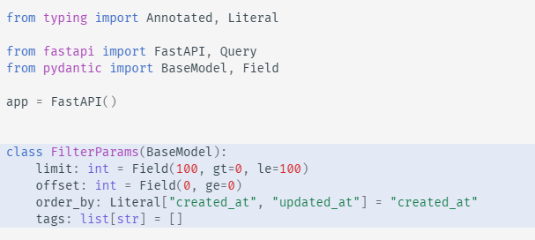
Query Parameters with a Pydantic Model

Slide 4
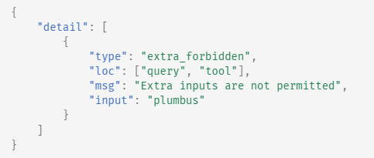
Forbid extra Query Parameters
Pydantic’s model configuration can be used to forbid any extra fields for restriction of Query parameters to receive.

Slide 5
Extra Data Types - FastAPI
FastAPI supports the following data types
int
float
str
bool
But FastAPI supports other data types as well (complex)
UUID:
Datetime.datetime:
Datetime.date:

Slide 6
Extra Data Types – Contd.
Datetime.date:
Datetime.time:
Datetime.timedelta:
Frozenset:
Bytes:
Decimal:

Slide 7
Cookie Parameters in FastAPI
In FastAPI, cookie parameters are declared using the Cookie() function from the fastapi module. This is used for reading cookies sent from the client in the HTTP request. To set a cookie in the response, you use the response.set_cookie() method.
To set a cookie, you must add a Response parameter to your path operation function and use its set_cookie method. This allows FastAPI to extract the cookie information from the temporary response and add it to the final response sent to the client.

Slide 8
Declare Header Parameters
In FastAPI, you define header parameters using the Header function within your path operation function's parameters. FastAPI automatically extracts the header value from the incoming HTTP request and passes it to your function.
Declare a header parameter
Optional Header: Provide a default value (e.g., None).
Required Header: Use ... (ellipsis) as the default value to make the header mandatory.

Slide 9
Form Models in FastAPI
To use Pydantic models with form data in FastAPI, you can declare a Pydantic BaseModel and then use the Form() annotation or default value for the input parameter in your path operation. This allows FastAPI to extract data from form fields and validate it using the Pydantic model.
Define a Pydantic Model: Create a class that inherits from pydantic.BaseModel to define the structure and validation rules for your form data.
Create a FastAPI Endpoint: Define a path operation (e.g., @app.post()).
Use the Form annotation: In the function signature, use your Pydantic model as the type and declare the parameter with Form().

Slide 10
Authentication & Authorization with FastAPI
FastAPI provides built-in tools and dependencies to streamline authentication (verifying user identity) and authorization (controlling user permissions), primarily using the OAuth2 framework and JSON Web Tokens (JWTs).
Authentication is the process of confirming who a user is, typically via a username and password.
Authorization determines what an authenticated user is permitted to do or access based on their assigned roles or permissions.
OAuth2 is a robust framework that defines different "flows" for handling security. In the context of a single FastAPI application, the "password flow" is commonly used, where the user exchanges credentials for an access token.
JSON Web Tokens (JWTs) are compact, URL-safe tokens used to transfer claims (like user ID and expiration time) between parties. They are the standard way to handle session data in modern stateless APIs.

Slide 11
Implement Auth Steps
Password hashing
Oauth2PasswordBearer
Creating & Verifying JWT
Securing Routes through Dependencies
Implementing Auth (Role based access control)

Slide 12
Migration of FastAPI Apps to Azure
Azure App Service is a fully managed web hosting service that supports Python apps hosted in a Linux server environment.
CI/CD: Deploy continuously with GitHub Actions, Azure Pipelines, and more. Deploy predictably through staging environments.
High-density hosting savings: Run more applications on fewer VMs with the memory-optimized P*mv3 tiers and save up to 55% on predictable workloads with Azure savings plans and reserved instances.
Full isolation: Secure ingress and egress with Azure Virtual Network integration, or run fully isolated applications with App Service environments, using dedicated networking and VMs.
Line-of-business: Develop business applications easily with built-in authentication, Microsoft Graph, and connectors to your line-of-business applications.
Reliability: Robust SLA and zone redundancy features help disaster-proof your application.
Security and compliance: ISO, SOC, and PCI compliance meet the strictest requirements of large enterprises.

Slide 13
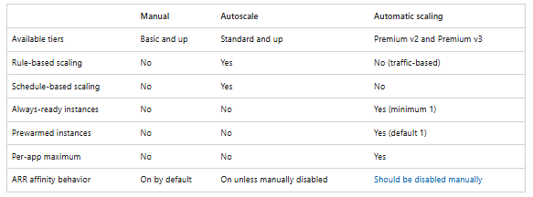
Azure App Service Scaling out Options

Slide 14
Deployment of FastAPI App with Azure
Pre-requisites
Python 3.10+
Azure Account
Configure a custom startup command that uses Gunicorn to run the asynchronous Uvicorn server, along with ensuring your dependencies are specified correctly.
Deployment can be done using the Azure CLI, Visual Studio Code extensions, or GitHub Actions.

Slide 15
Background Tasks Mgmt in FastAPI
You can define background tasks to be run after returning a response.
This is useful for operations that need to happen after a request, but that the client doesn't really have to be waiting for the operation to complete before receiving the response.
This includes, for example:
Email notifications sent after performing an action:
  As connecting to an email server and sending an email tends to be "slow" (several seconds), you can return the response right away and send the email notification in the background.
Processing data:
  For example, let's say you receive a file that must go through a slow process, you can return a response of "Accepted" (HTTP 202) and process the file in the background.

Slide 16
Create a Task function
Create a function to be run as the background task.
It is just a standard function that can receive parameters.
It can be an async def or normal def function, FastAPI will know how to handle it correctly.
Inside of your path operation function, pass your task function to the background tasks object with the method .add_task():

Slide 17
Overview of Alembic
Alembic provides for the creation, management, and invocation of change management scripts for a relational database, using SQLAlchemy as the underlying engine.
Usage of Alembic starts with creation of the Migration Environment. This is a directory of scripts that is specific to a particular application.
The migration environment is created just once and is then maintained along with the application’s source code itself. The environment is created using the init command of Alembic and is then customizable to suit the specific needs of the application.

Slide 18
Alembic Benefits
Version Control for Your Database: Alembic acts like "Git for your database schema," allowing you to track every change (e.g., adding a table, renaming a column) as an explicit, versioned step in a migration script. This provides a clear, auditable history of modifications.
Consistency Across Environments: It ensures that every developer, testing environment, and the production database uses the exact same schema evolution process. This eliminates "schema drift" and prevents issues caused by manual errors during deployment.
Safe Upgrades and Downgrades (Rollbacks): Each migration script contains instructions for both applying the changes (upgrade) and reversing them (downgrade). This provides a crucial safety net, allowing you to revert to a previous, stable state if a new release encounters problems.
Streamlined Collaboration: Each developer's schema changes are captured in migration files that are checked into the source code repository. Team members can easily pull the latest changes and run a single command to sync their local databases.
Automation and CI/CD Integration: Migrations can be easily integrated into Continuous Integration/Continuous Deployment (CI/CD) pipelines, automating the process of applying database changes during deployment. This makes releases more reliable and predictable.
Pythonic API and SQLAlchemy Integration: Migration scripts are written in Python, allowing developers to leverage the full power and readability of Python code. It works hand-in-hand with SQLAlchemy, the most popular Python ORM, and can automatically generate draft migration scripts based on model definitions.
Database Agnostic: Alembic supports all major databases that SQLAlchemy works with, including PostgreSQL, MySQL, and SQLite, making it a versatile choice for diverse projects.

Slide 19
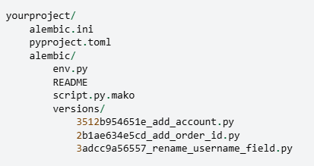
Directory Structure
Alembic.ini -> This is Alembic’s main configuration file which is generated by all templates.
Pyproject.toml – Alembic may store optionally project related configuration.
Yourproject – root of the application.
Alembic – The directory lives within the application source tree and source of migration.
env.py – part of generated environment so that the migration runs are entirely customizable.

Slide 20
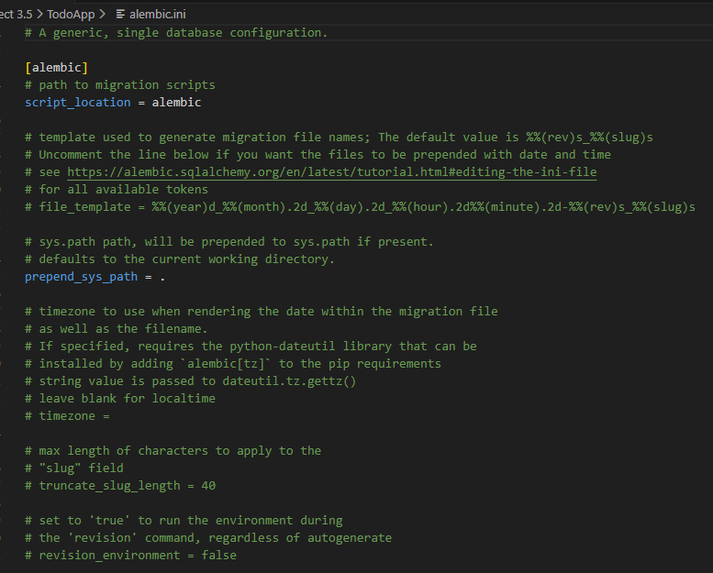
Alembic .ini file

